Slide 1
Efficient and electric homes
The foundation of clean, sustainable energy use for your life
March 2021

Slide 2
What is EBCE?
East Bay Community Energy (EBCE) is our local power supplier committed to providing Alameda County and the city of Tracy with cleaner, greener electricity at lower rates. EBCE reinvests earnings back into the community to create local green energy jobs, local energy programs, and clean power projects.

Slide 3
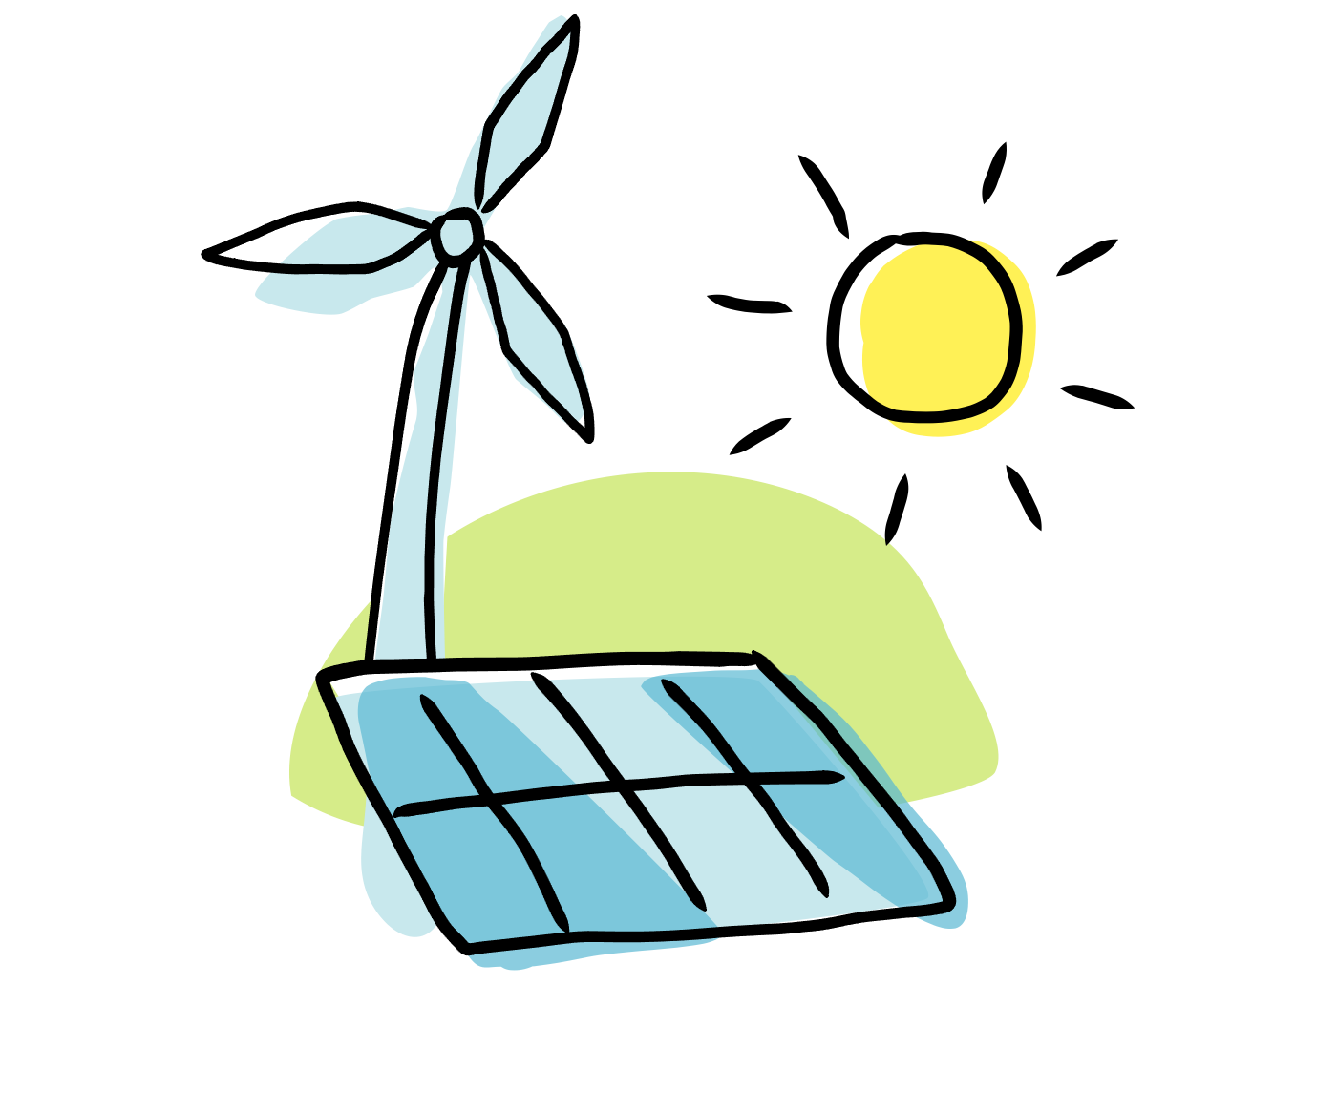
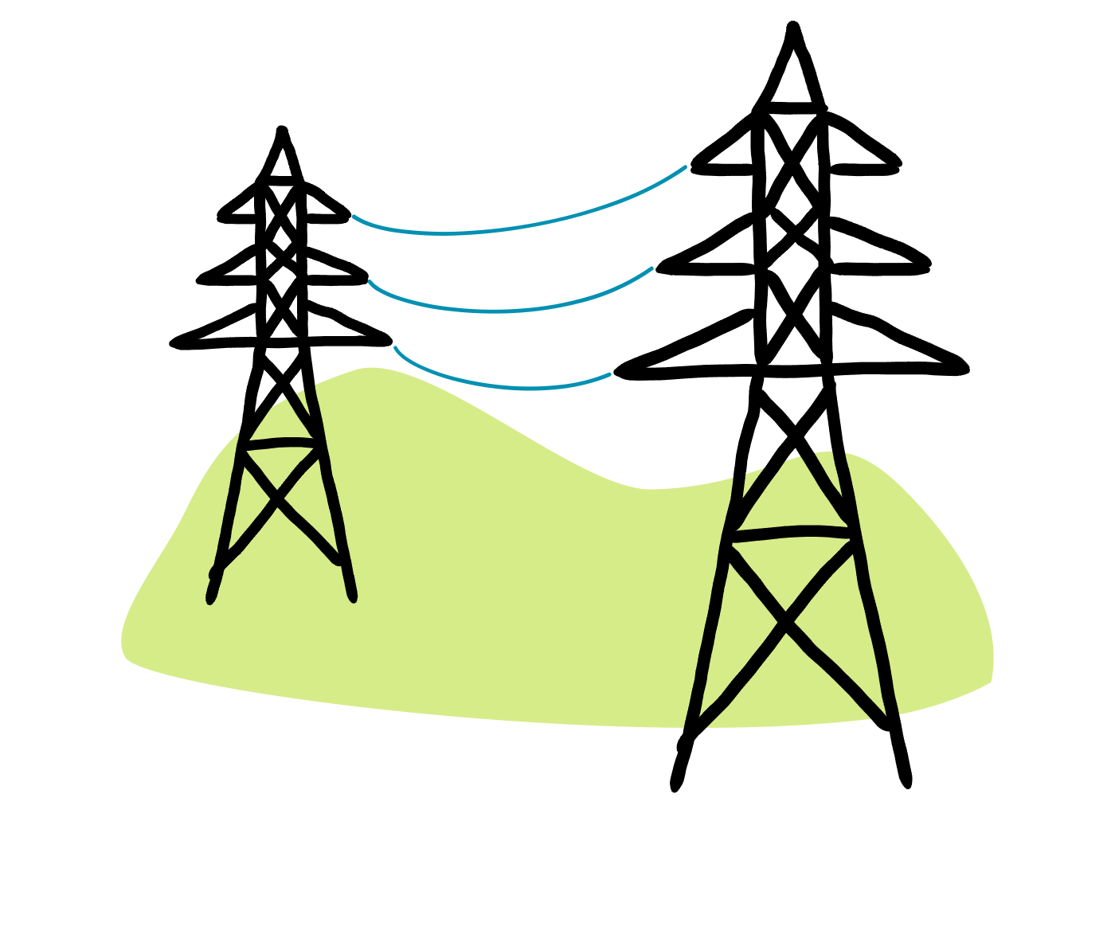
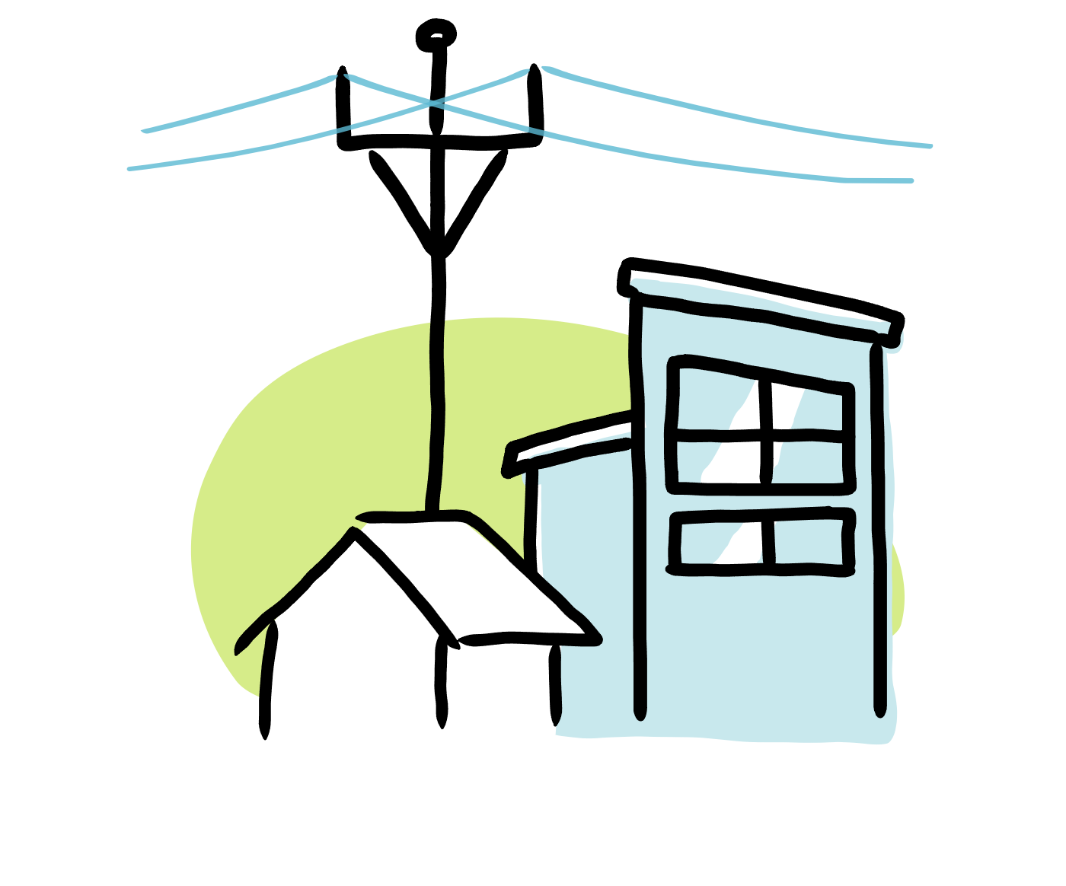
How it Works
EBCE BUYS CLEAN POWER
EBCE buys from, and is building, clean power plants. EBCE sells the power to customers at low rates.
PG&E DELIVERS THE POWER
EBCE’s power is delivered to customers by PG&E. Customers pay PG&E for power delivery as they always have.
YOU GET THE POWER AND ALL THE BENEFITS
You benefit from cleaner energy, low rates, local governance, and innovative programs.

Slide 4
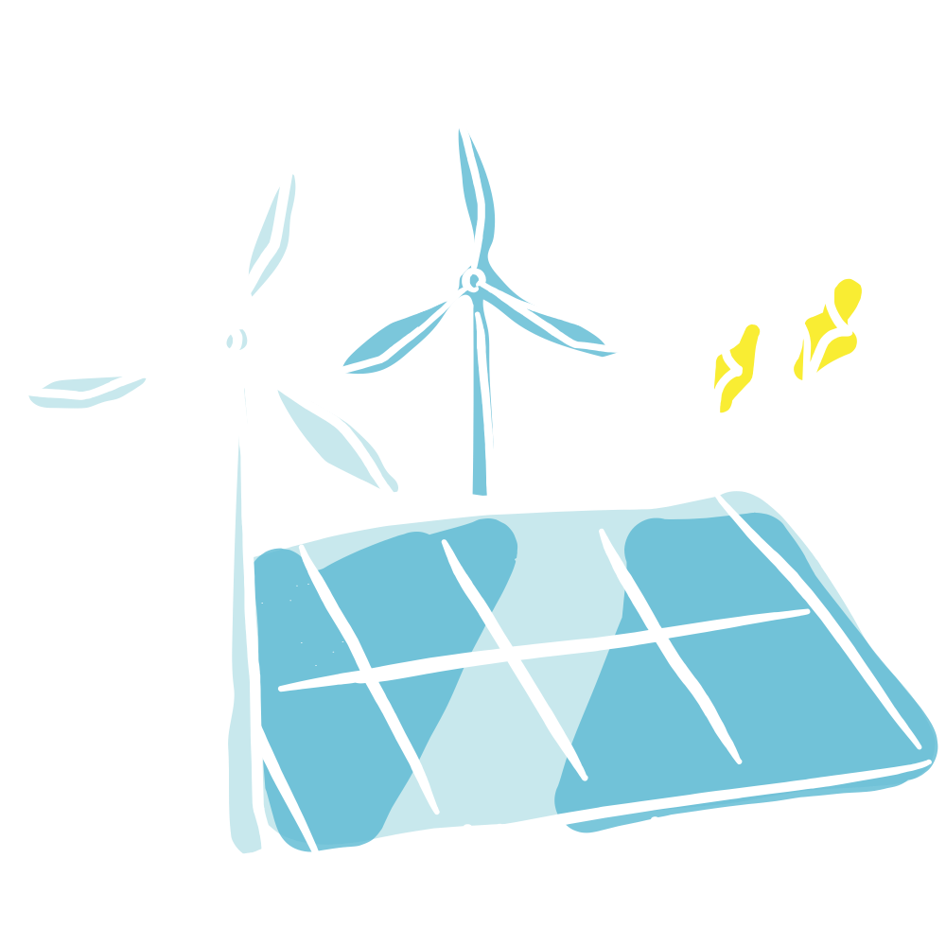
What Are the Benefits?
LOWER RATES
LOCAL CONTROL & INVESTMENT
SUSTAINABILITY
CUSTOMER CHOICE & PROGRAMS

Slide 5
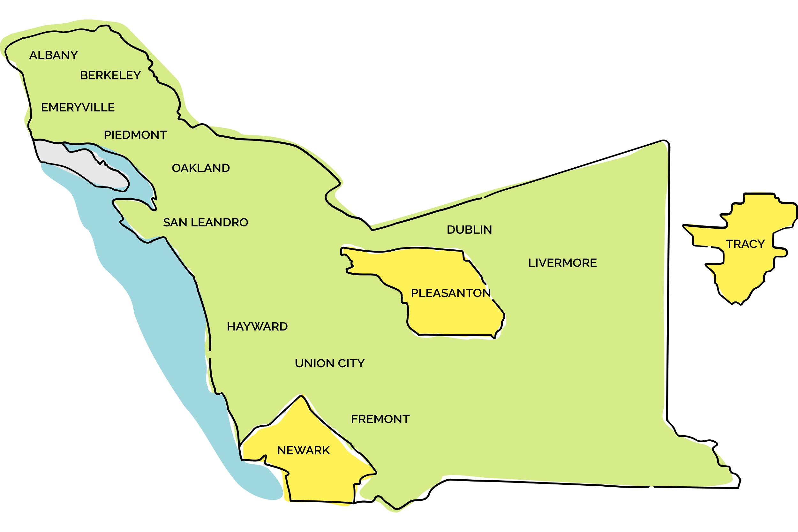
EBCE Members

Slide 6
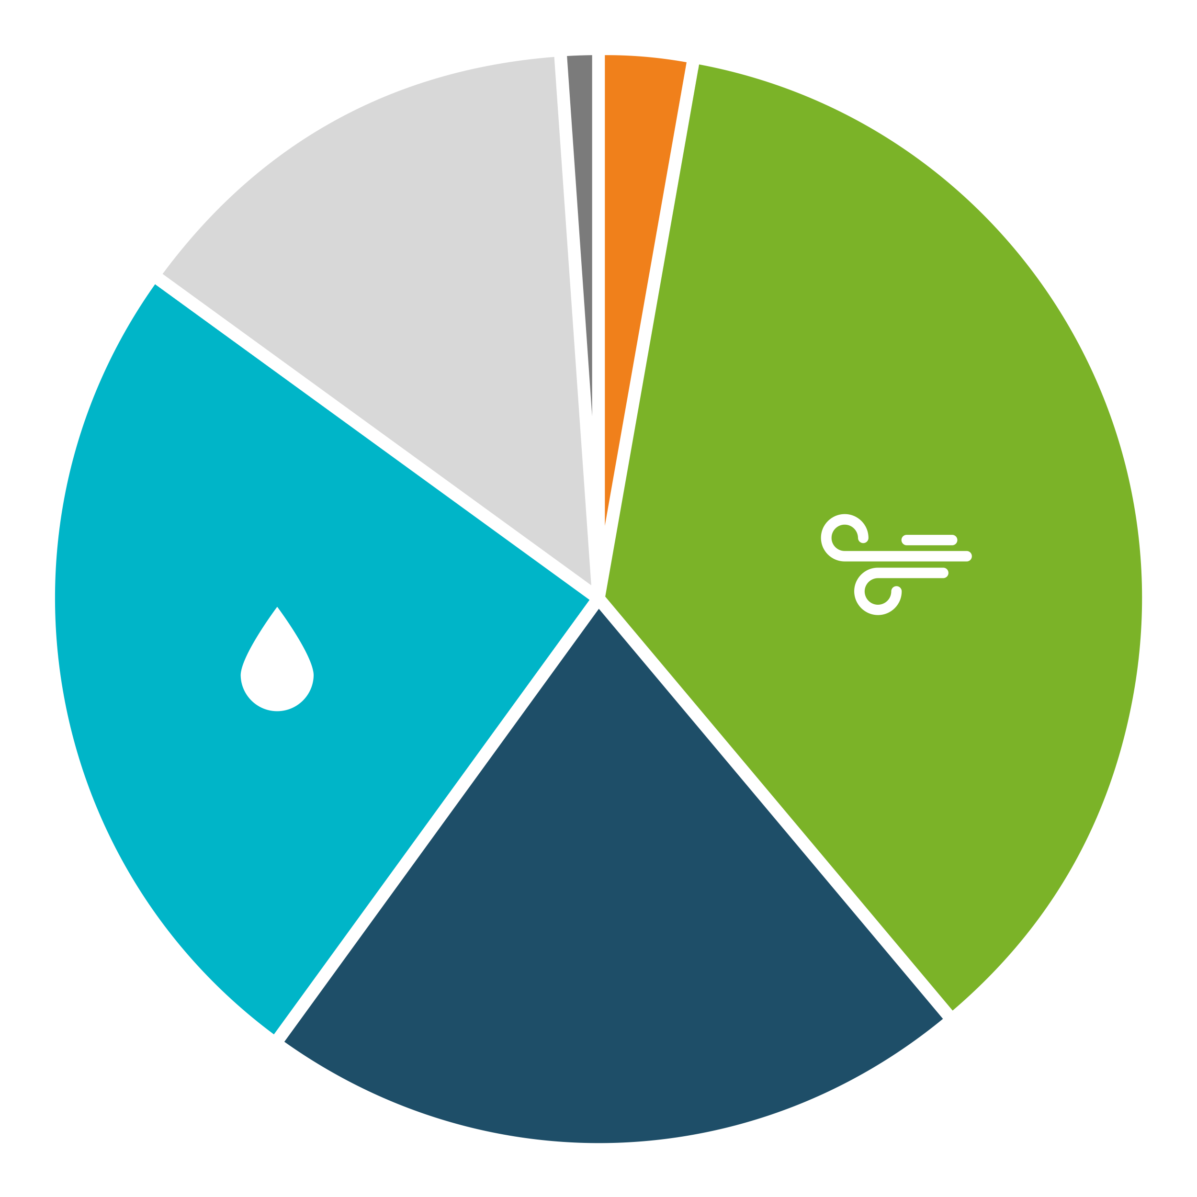
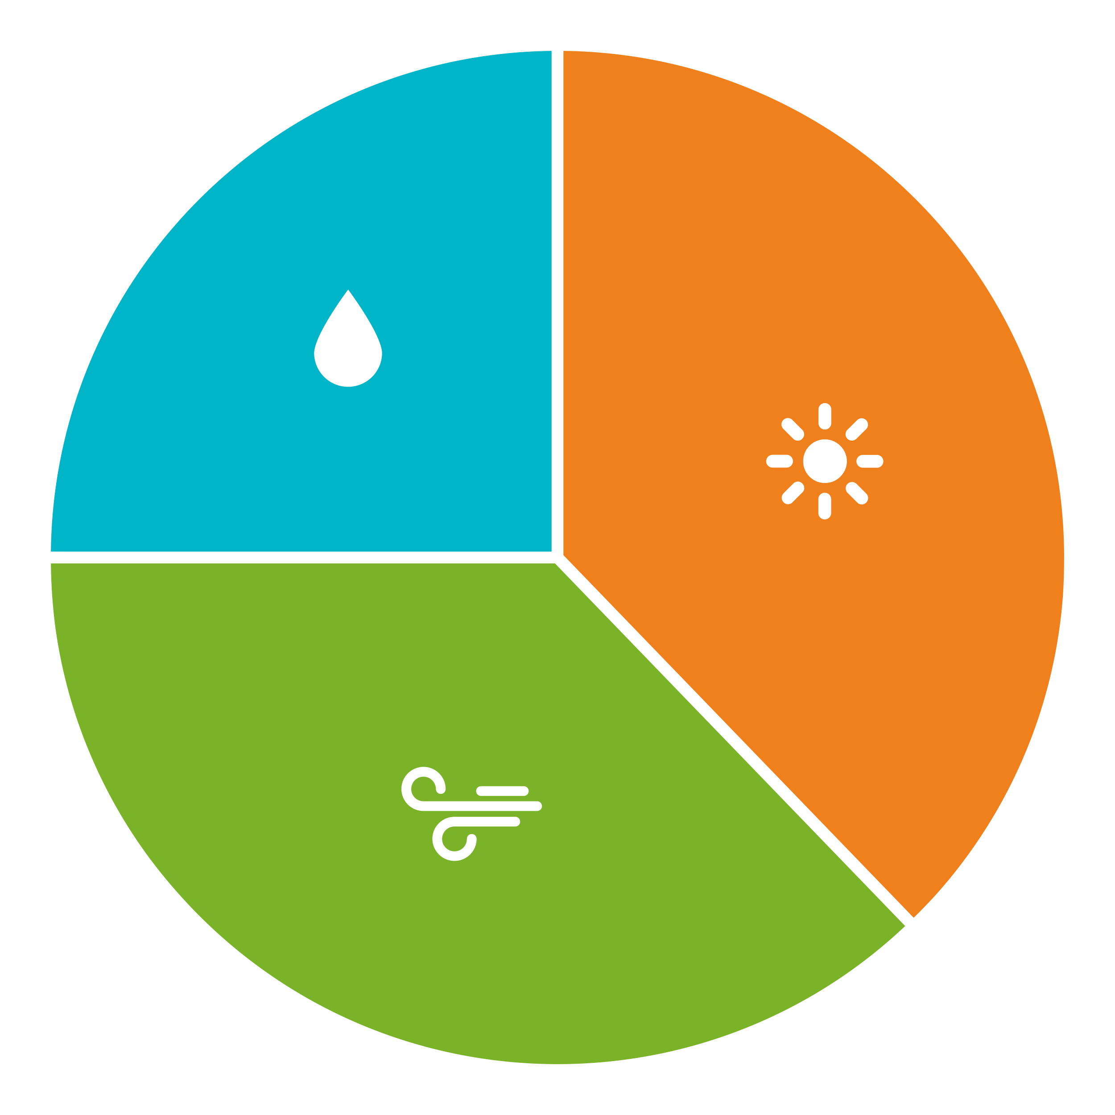
What Are My Options? ebce.org/change-my-plan
BRIGHT CHOICE
at least 5% more renewable energy than state requires at rates 1% below PG&E
BRILLIANT 100
100% carbon-free energy including hydropower at the same rates as PG&E
RENEWABLE 100
100% California solar & wind energy at 1 cent per kilowatt-hour above PG&E rates

Slide 7
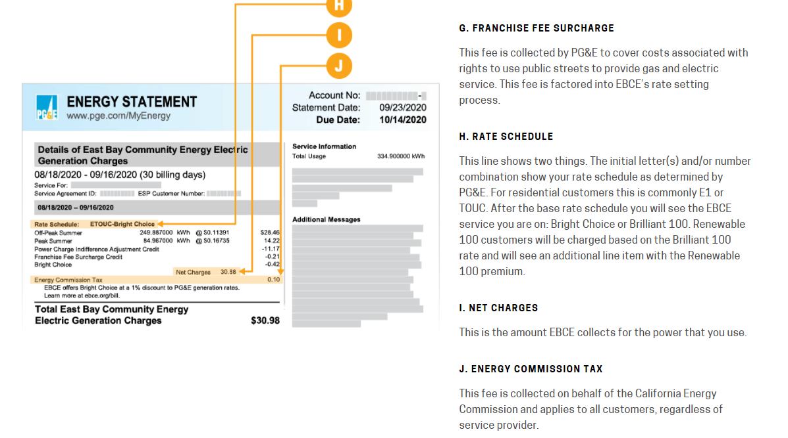
Understanding Your Current Rate (pg 4)

Slide 8
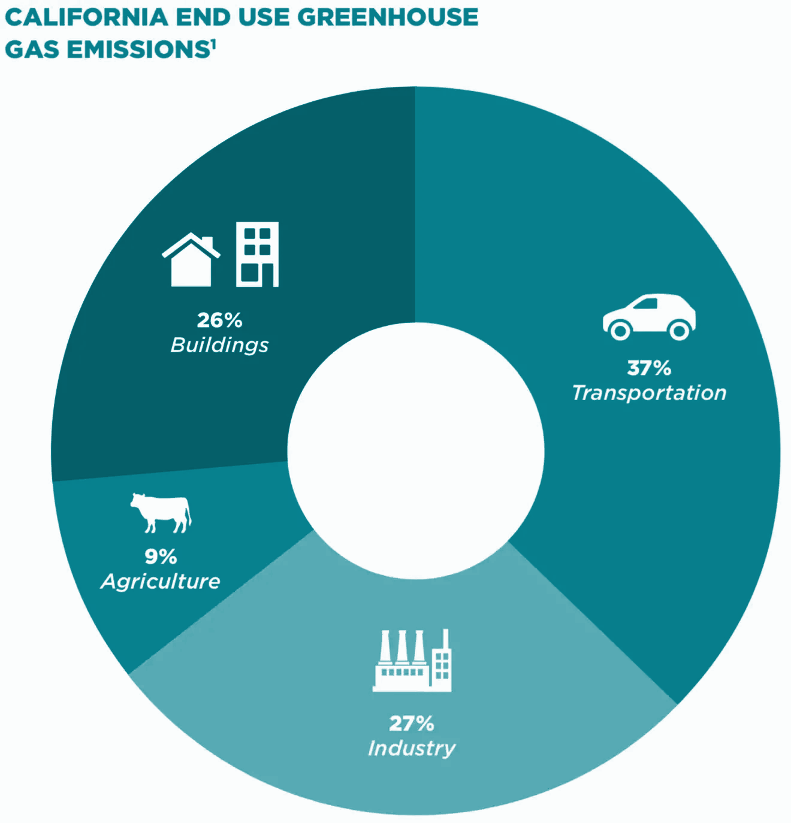
Our Buildings
Gas
Electricity
Source: Building Decarbonization Coalition

Slide 9
Building Electrification
Gas Powered
All-Electric
Heat Pump Water Heating
Heat Pump Space Heating
Heat Pump Clothes Drying
Induction Cooking
Gas Water Heating
Gas Space Heating
Gas Clothes Drying
Gas Cooking
Gas
Electricity

Slide 10
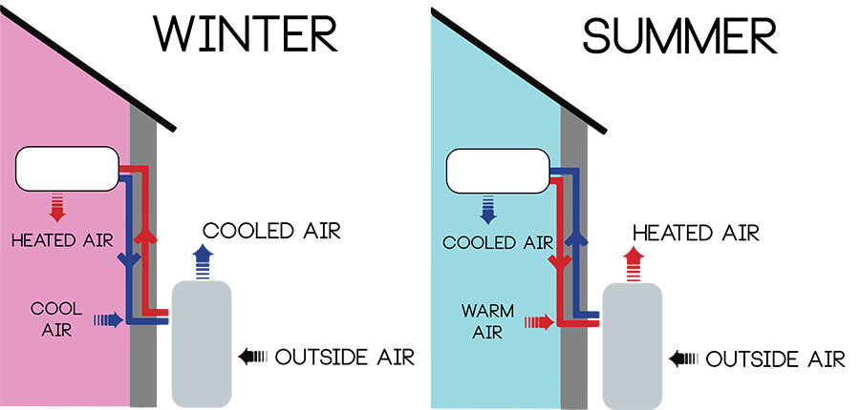
Electrification Technologies Heat Pump
Your refrigerator moves warmth from the inside to outside in order to keep food cold. Heat pumps do the same and can move in either direction to either heat or cool air or water.
Heat Pumps are
Energy efficient
All-electric
Better for indoor air quality
Capable of heating and cooling
Source: Amanda Reed, River Reporter

Slide 11
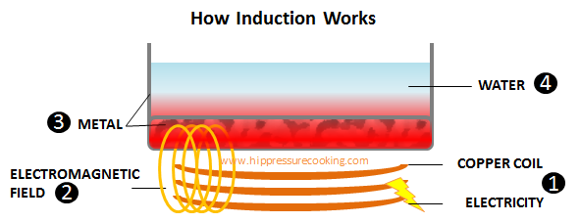
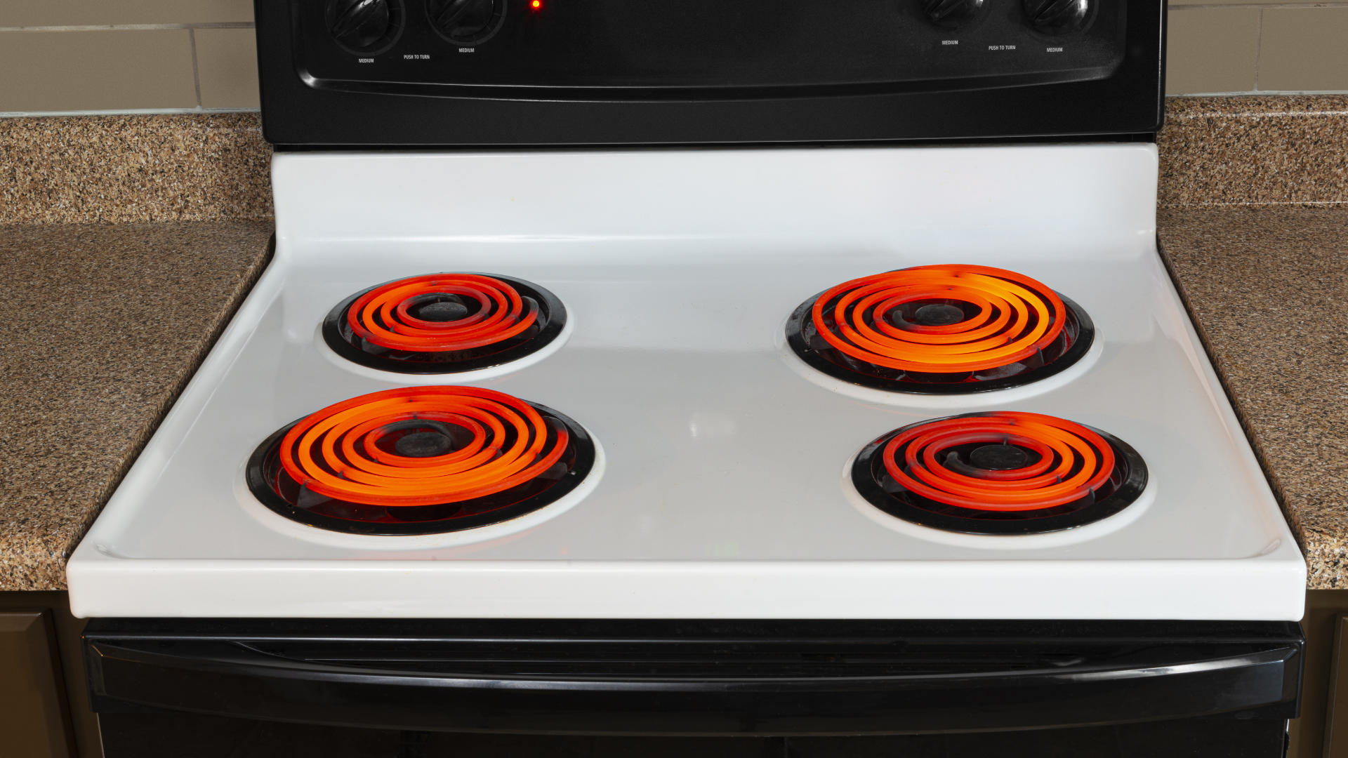
Electrification Technologies Induction
Induction Cooktops are
Energy efficient
All-electric
Better for indoor air quality
Safer
Fast, powerful, and capable of specific cooking techniques
Induction technology works by using electricity to create a magnetic field which directly causes cookware to heat. This is different than gas or electric resistance which use flame and hot coils to heat cookware.
Induction is not electric coils

Slide 12
Benefits of Electrification
Climate Change
Cost Savings
Resilience and Safety
Powering appliances with increasingly renewable electricity reduces your greenhouse gas emissions
As our gas system ages and more people electrify, gas prices are projected to increase.
Shield yourself by electrifying.
Natural gas explosions and failures can be dangerous. Battery storage offers greater energy independence.
Health & Comfort
Green Jobs
Equity
Frontline communities are greatest affected by adverse climate impacts. Electrification offers health and safety benefits.
Electrification eliminates indoor air pollutants associated with the combustion of gas.
Electrification opens doors for green careers helping us making the energy transition.

Slide 13
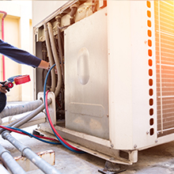
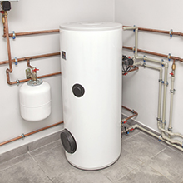
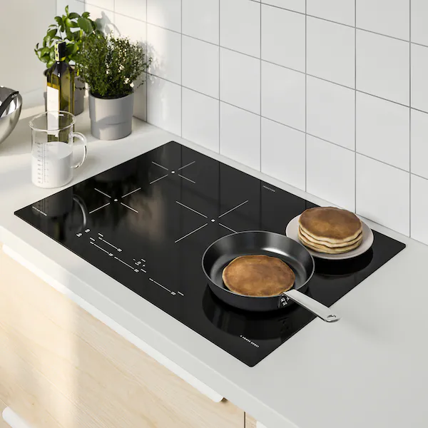
How to Electrify
Contact a Home Energy Advisor
866-878-6008 or bayrenresidential.org
Access Rebates & home energy assessment!
$300 Rebate
Heat Pump Dryer
Up to $1,000
Rebate
Heating & Cooling
Up to $2,000
Rebate
Water Heating
$300 Rebate
Induction Cooking

Slide 14
Low-Cost Energy Efficiency
Check your temp!
Air & AC
Set your thermostat to 68 degrees (or lower) in the winter and 78 degrees (or higher) in the summer
Check your water heater - set it at 120 degree to save energy
Fans keep air circulating and you comfortable with less work and energy from your air conditioner
Dirty air filters make your air conditioner work harder to circulate air. Cleaning or replacing filters monthly can reduce cost and increase efficiency.
Lighting
Plug Load
Replace old light bulbs with high-efficiency LEDs to save energy and $
Automatic lighting controls make utilization more efficient
Unplug small appliances when not in use
Save $ by using electricity outside of 4-9pm when it’s most expensive

Slide 15
Resilient Home + Webinars
Residential solar + battery backup
Connect interested customers with a vetted solar installer for preferred pricing
$1,250 incentive to share power when demand is high
ebce.org/resilient-home

Slide 16
Q & A
Habitat for Humanity is honored to partner with East Bay Community Energy. From their support of affordable housing to promoting women in leadership, EBCE cares about the communities and people they serve.”
— Habitat for Humanity East Bay/Silicon Valley
EBCE, the City of Fremont, and many others are working together to create a healthy, safe, and vibrant future for our comm-unity. Reach out to EBCE to hear about what is in the works and to make sure your business goals are aligned with your energy choices.”
— Rachel DiFranco, Sustainability Manager, City of Fremont

Slide 17
Thank You!
Questions? Give us a call:
1-833-699-EBCE (3223)
@PoweredbyEBCE
customer-support@ebce.org
ncordoba@ebce.org
Español
ebce.org/es
中文
ebce.org/cn

